Slide 1
Spawning Ground Survey Database Quality Assurance and Quality Control

Slide 2
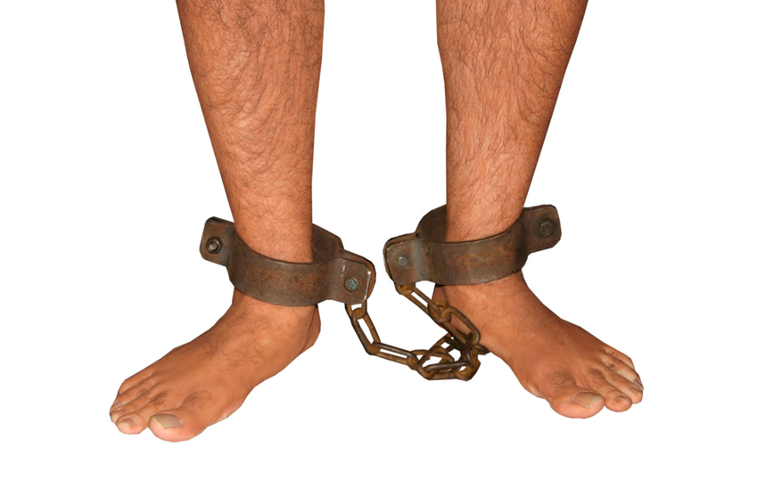
Quality Control
We can use protocols and database rules to control the data which we enter

Slide 3

Quality Assurance
We can use our knowledge and logic to assure the data we enter is complete and correct

Slide 4

Data Flow
Multiple Field Versions and one Coordinator Version
Notes:
Data flow should be from raw data entered into a Field Version SGSA, transferred to a Coordinator Version, then uploaded to SGS

Slide 5
Data Flow
No Field Versions and one Coordinator Version
Notes:
Reduced opportunities for QAQC due to fewer steps and fewer eyes looking it over

Slide 6
Error Control
Errors Fixed by Protocols
Errors Fixed by QAQC

Slide 7
Errors Fixed By Protocols
Bad BioSample ID or no BioSample ID entered when a sample was taken for fin ray, DNA or otoliths
Notes:
Key field linking SGS to BioSamples age data

Slide 8
Errors Fixed By Protocols
Not entering marks
Set protocols to make sure you enter either:
  Marks observed (AD, PIT, CWT, OP, etc.)
  No marks (i.e. wild fish)
  Unknown (e.g. fungus fish, skeleton)
Notes:
Easy button for AD clip, No Marks, and Unknown

Slide 9
Errors Fixed By Protocols
Not entering tags and tag numbers
Entering them incorrectly
Notes:
Copy and paste PIT codes whenever possible

Slide 10
Errors Fixed By Protocols
Carcass Count field = false but sum of carcass > 1
Carcass only surveys should have Carcass Count true AND Redd Count false
Notes:
If you are surveying for carcasses, then you must check the Carcass Count box and indicate number of carcasses observed

Slide 11
Errors Fixed By Protocols
Redd Count field = false but sum of redds >0
Notes:
If you are surveying for redds, then you must check the Redd Count box and indicate number of redds observed

Slide 12
Errors Fixed by QAQC
Not recording ALL the samples that were taken

Slide 13
Errors Fixed by QAQC
Not entering waypoints even though they were recorded (written on envelopes, but not entered in SGS)
Notes:
Import waypoints from CSV or copy and paste from Excel

Slide 14
Errors Fixed by QAQC
Missing or double entering carcass or redd count data
Coordinators need to coordinate
Notes:
Get data collected by others in your area from SGS Reports or SGSA Export

Slide 15
Errors Fixed by QAQC
Survey boundaries should be landmarks like streams or bridges as much as possible
  NOT random points along a stream without a waypoint name
Notes:
Plan ahead, fill out survey form headers, copy waypoints to gps units

Slide 16
Errors Fixed by QAQC
Bad waypoints from typing in Lon Lat values instead of Importing or copying/pasting

Slide 17
Errors Fixed by QAQC
If an index redd count was NOT completed, then:
  “Survey Was Not Taken” box checked
  survey record should have sum of redds Is Null
  Survey Dates = 1/1/YYYY to 12/31/YYYY
  Survey Note explaining why it was not done
Notes:
South Fork Salmon River, NS-26, 1/1/2008 to 12/31/2008, Not surveyed due to wildfires

Slide 18

Managing Waypoint Data
Notes:
Almost all of our data is georeferenced and very useful navigation tools

Slide 19
Managing Waypoint Data
Use Excel template to compile waypoint data throughout the season.
Example workbook at end of User Manual
Excel template off of IFWIS SGS web page as starting point
Notes:
Download gps units to CSV and then copy and paste to excel after each 10 day shift for example

Slide 20
Managing Waypoint Data
Differentiate between redds, carcasses, and boundaries in waypoint name
  SF01R001
  SF01C001
  SF01TOP

Slide 21
Managing Waypoint Data
QAQC waypoint data before entering into SGS
For example, was that redd really in Afghanistan?

Slide 22
Managing Waypoint Data
Easily access waypoints for re-use in subsequent years
Is “Top of Meadow” the same place in 1992 and 2092?

Slide 23
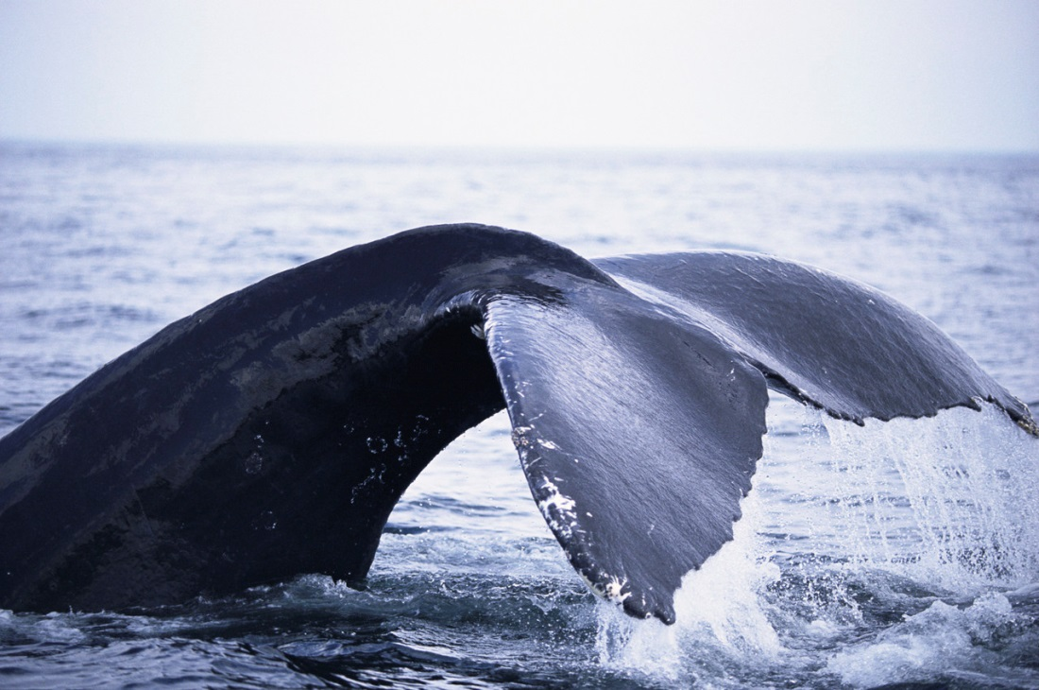
The End

