Slide 1
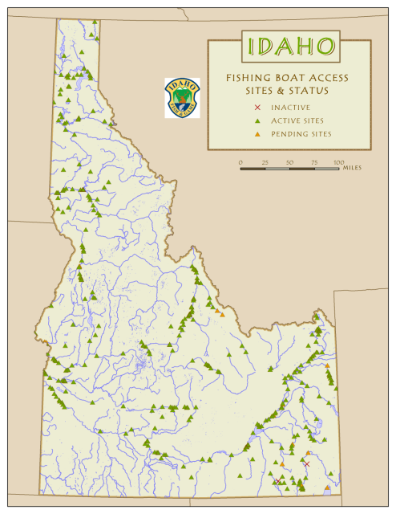
Remove Logo Background in a GIS map * A Step-by-Step Guide (in only 7 slides)
Gee, I spent all morning on this map but the background on the logo really looks bad!
* The logo must be in .bmp (bitmap) format.
Do you want to add a logo but the background shows up
on your GIS map?
This may be the help you need.
Designed by Idaho Fish and Wildlife Information System for IDFG use.
Methods apply broadly and can be implemented by most GIS users.

Slide 2
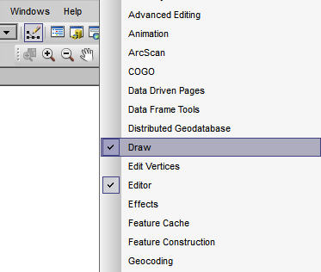
In your ArcGIS map project, enable the Draw toolbar if necessary…
Right-click near the top of your project and select Draw
from the list of tool options.
The Draw toolbar looks like this:
TIP: Your toolbar may automatically dock below the map window, but it can be moved;
click the handle (dots) on the left side and drag to move it out of the way but handy.

Slide 3
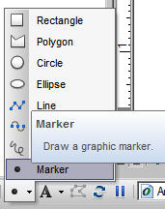
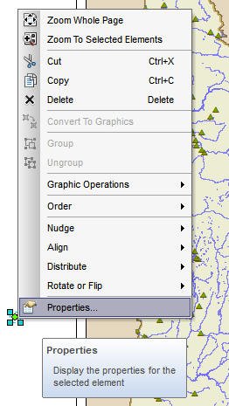
Click on the Graphics menu on the Draw toolbar; select Marker
Click anywhere in your project
(layout view) to add the new marker.
Right-click
on the Marker; select Properties

Slide 4
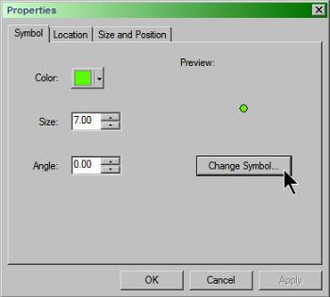
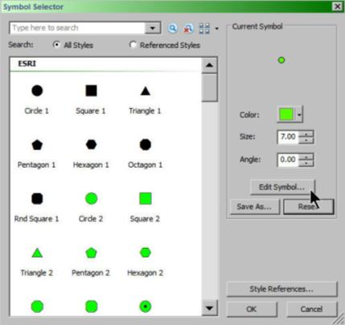
In Marker Properties,
select Change Symbol
Select Edit Symbol.

Slide 5
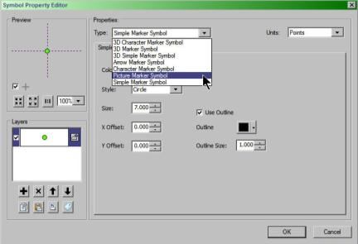
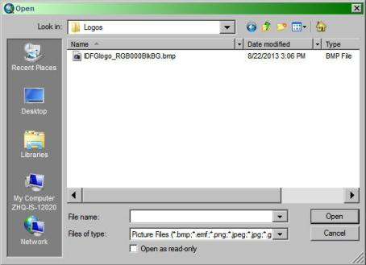
In the Symbol
Property Editor,
Change Type to
Picture Marker Symbol
Browse to open your .bmp logo. *
* If you are a F&G employee with network access, a .bmp logo can be found here:
K:\IFWIS\Logos\IDFGlogo_RGB000BlkBG.bmp

Slide 6
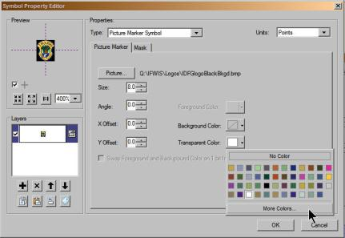
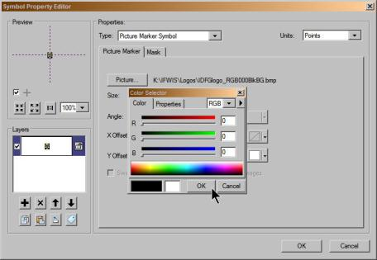
For Transparent Color,
Select Black
(In More Colors, make sure the color settings = RGB 0/0/0.)
TIP: You can use this process for any other logo or graphic; make sure it is created with a background color you will remember (by RGB, HSV, or CMYK); note and save it in .bmp format. *
Assign a contrasting background color that it NOT a part of the graphic or that part of your graphic will also become transparent with this method. In this case, the background is black (RGB 000).
* This will require image editing software like PaintShop Pro or Photoshop (or a designer friend).
Click OK >>> OK

Slide 7
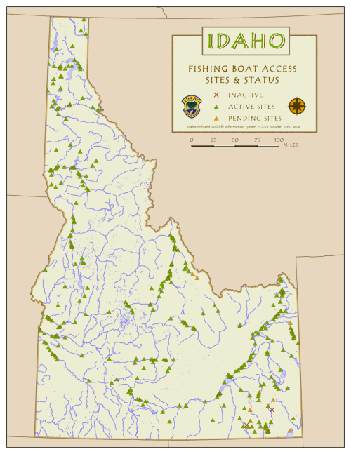
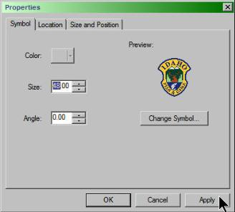
Specify logo size
(select size you prefer.)
Reposition the logo where you want it,
add your final details,
and you’re done!
Topic design by Cyndi Coulter with Pam Bond
Idaho Fish and Wildlife Information System
Idaho Fish and Game <> 2013

